Slide 1
Sports Videos Classification Using Motion Information and Deep Learning Techniques
Anmol Dutta, Biswajit Nayak, Debaprasad Badajena
NIT Rourkela
Under the supervision of:
Dr. Partha Pratim Mohanta
ECSU
ISI Kolkata

Slide 2
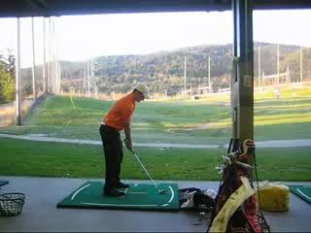

Slide 3
Problem Statement
Performing Sports Classification on unconstrained videos taken from benchmark datasets.
It is a challenging task because videos are taken by unprofessional and suffer from different quality aspects such as poor lighting, occlusion and inadvertent camera motion.

Slide 4

PROPOSED METHODOLOGY
DATA
EXTRACTION
MAGNITUDE MATRIX
SLOPE MATRIX
VGG-16
VGG-16
LSTM
LSTM
FUSION

Slide 5
Dense Optical Flow
Pattern of apparent motion of image objects between consecutive frames
Assumption that the pixel intensities of an object do not change between consecutive frames and neighboring pixels have similar motion.
We get a 2-channel array with optical flow vectors (magnitude, slope).

Slide 6
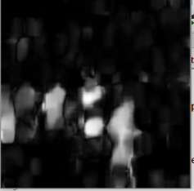
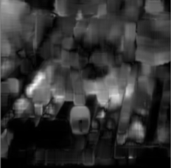
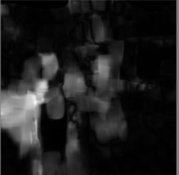
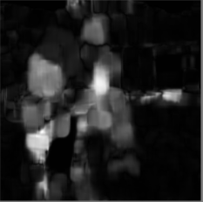
Bowling Volleyball
Archery Archery
Fig: Dense Optical Flow From Different Sports Classes

Slide 7
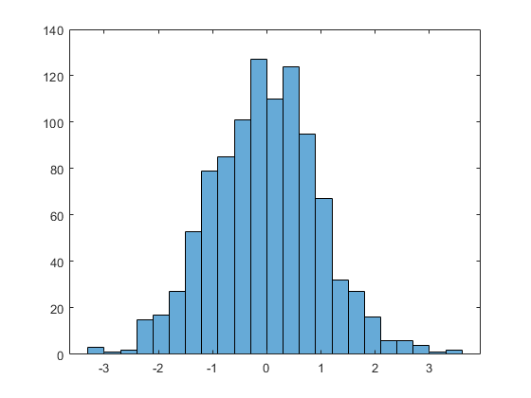
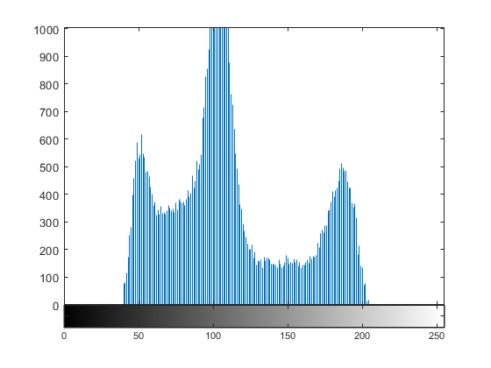
K-Means Application
+
=
Magnitude Histogram
Slope Histogram
32 bin histogram
Selection of 5 frames from a Video
k-Means
Clustering

Slide 8
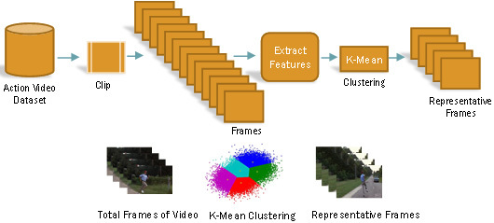

Slide 9
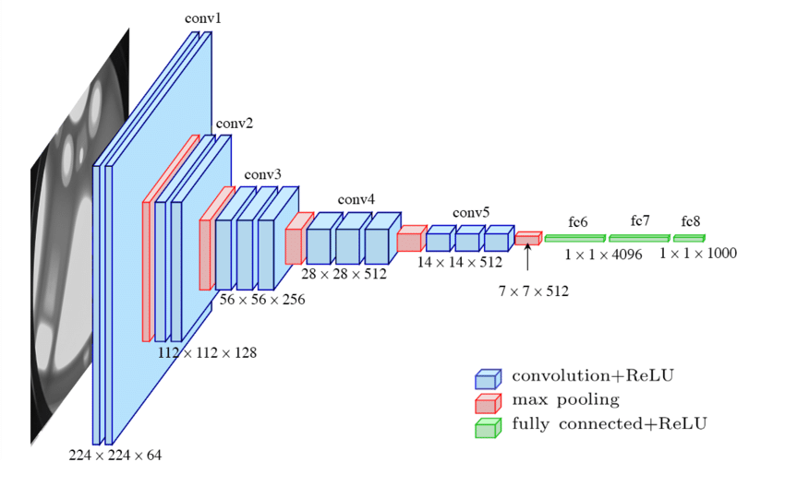
CNN Model VGG-16

Slide 10
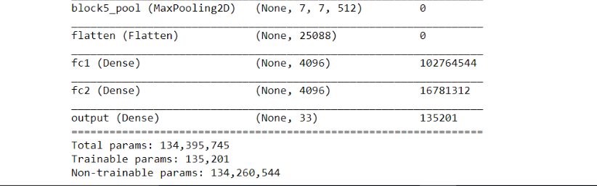
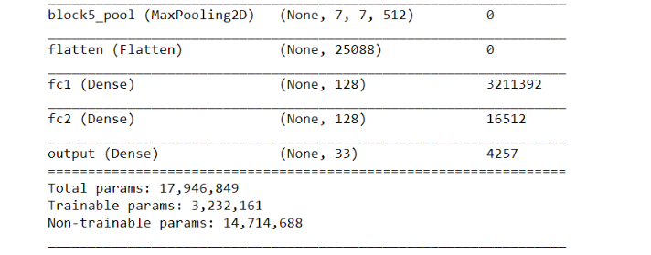
11st VGG Model
Custom VGG Model

Slide 11
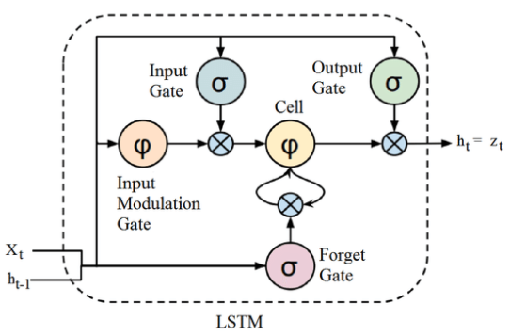
Long Short Term Memory(LSTM):
Extended form of RNN which can find temporal-sequential patterns in time series data
Solution to the vanishing gradient problem of simple RNN, which is not able to learn long-term sequences and loss the effect of initial dependencies in the sequence
Specially designed to avoid the long term dependency problem

Slide 12
VGG-Mag
Output
VGG-Ang
Output
Reshape into
(no. of Videos, no. of frames, classes)
Y_TEST of VGG16 is modelled as Y_TRAIN_LSTM
Reshape into
(no. of Videos, no. of frames, classes)
LSTM-Mag
Input
LSTM-Ang
Input

Slide 13
Fusion Technique
DATA
EXTRACTION
MAGNITUDE MATRIX
SLOPE MATRIX
f(x)
f(y)
FUSED RESULTANT MATRIX
f(x, y)
Prod uct Rule:
f(x, y) = f(x).f(y)

Slide 14
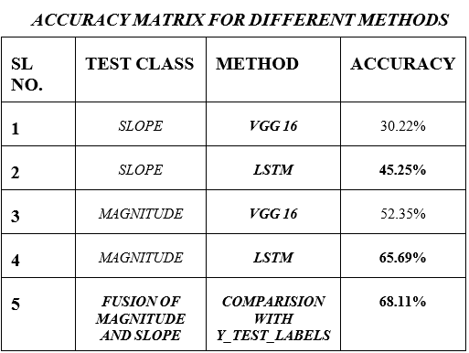

Slide 15
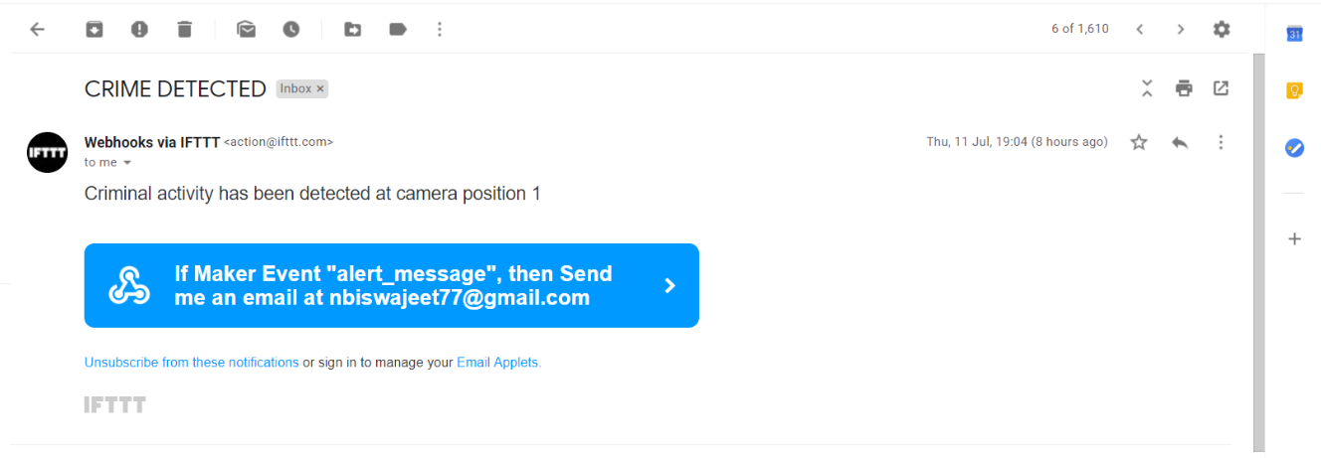
Applications

Slide 16
Scope for Improvements:
More Datasets
Dynamic k value in k-Means Clustering
Data Augmentation
Improvisation in Fusion Technique

Slide 17
Improvised Fusion Technique:
DATA
EXTRACTION
MAGNITUDE MATRIX
SLOPE MATRIX
VGG-16
VGG-16
FUSION
LSTM

Slide 18
THANK YOU

